Slide 1

Modeling spatial uncertainty
Modeling Uncertainty in the Earth Sciences
Jef Caers
Stanford University

Slide 2
A reminder: models of uncertainty
A set of samples drawn by Monte Carlo simulation
are a valid model of uncertainty

Slide 3
Motivation

Slide 4
Spatial stochastic simulation
Modeling spatial uncertainty

Slide 5
Spatial stochastic simulation
Earth models
Seed 1
Seed 2
(input uncertainty)
Spatial
Stochastic
simulator
input
(spatial uncertainty)
Conditional simulation
= constrained to data
Unconditional simulation
= not constrained to any data
Data
(samples, well, geophysics…)

Slide 6
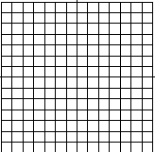
“Hard” data
Definition: Hard data = direct, exact information at the scale of modeling
All the rest is soft data
If you dig out a volume of this size
at that location and measure the variable of interest than you have hard data

Slide 7
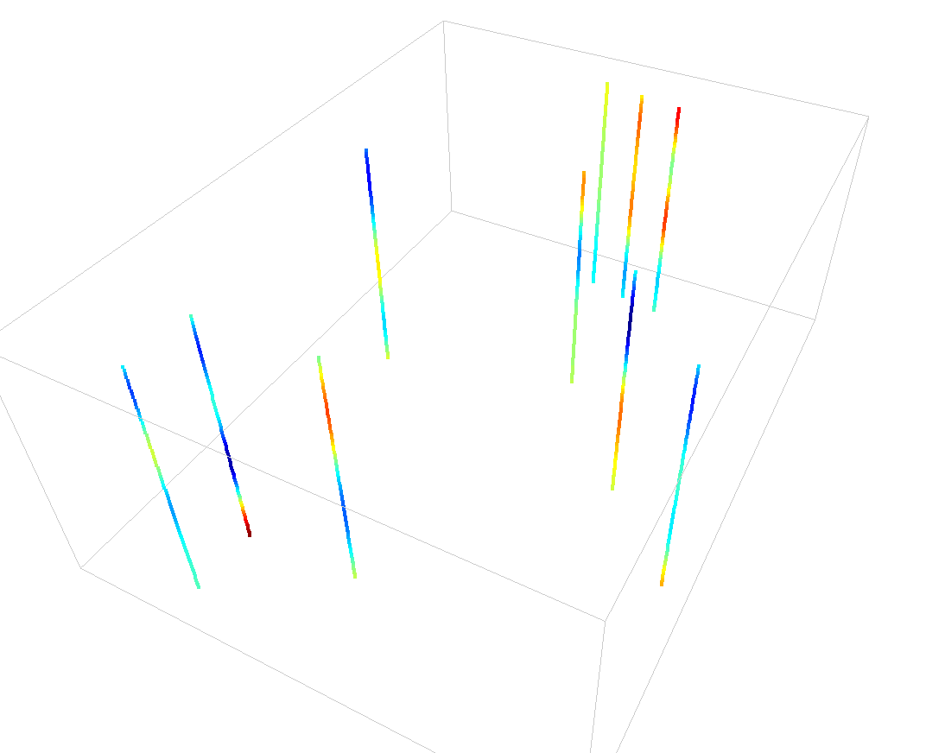
Example
Size of the core =
6 inch x 6 inch x 12 inch
1 grid cell =
200ft x 200 ft x 3 ft
5 miles
Grid cells
If we assume the core to be hard data, i.e. assign it to a grid cell then we basically assume that there is NO spatial variation in that grid cell

Slide 8
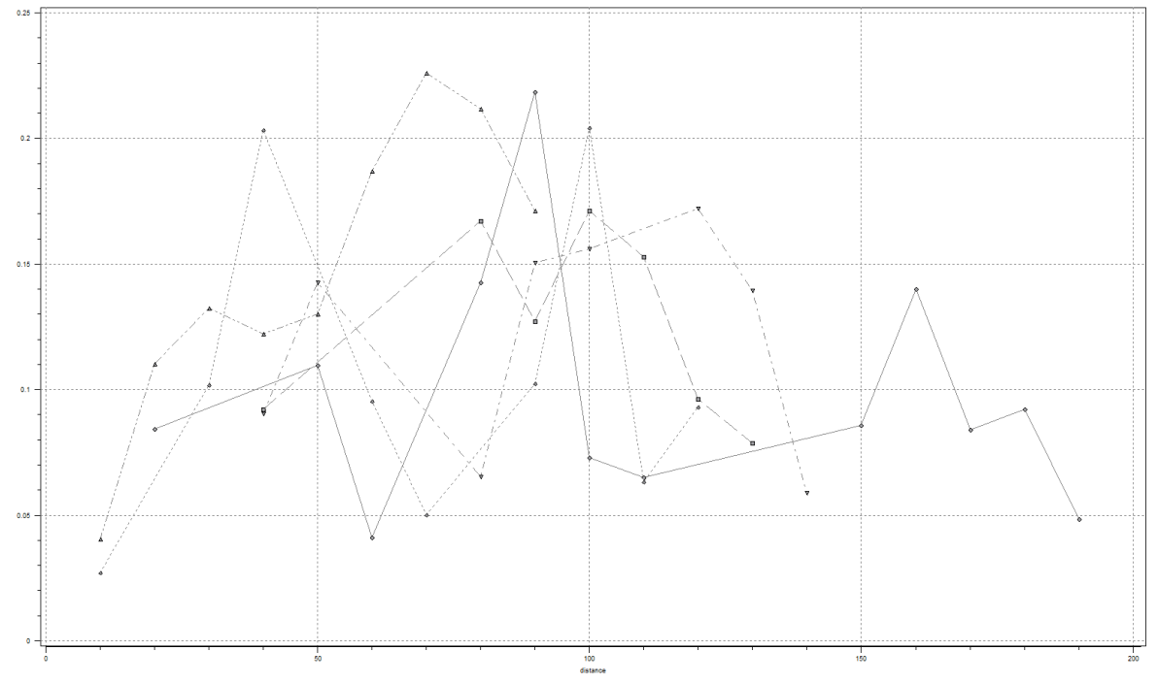
Example spatial stochastic simulation
Input uncertainty:
Range horizontal= [15,25]
Range vertical = 5
Isotropy or horizontal anisotropy
max range = [20,25]
min range = [10,15]
Azm=45
?

Slide 9
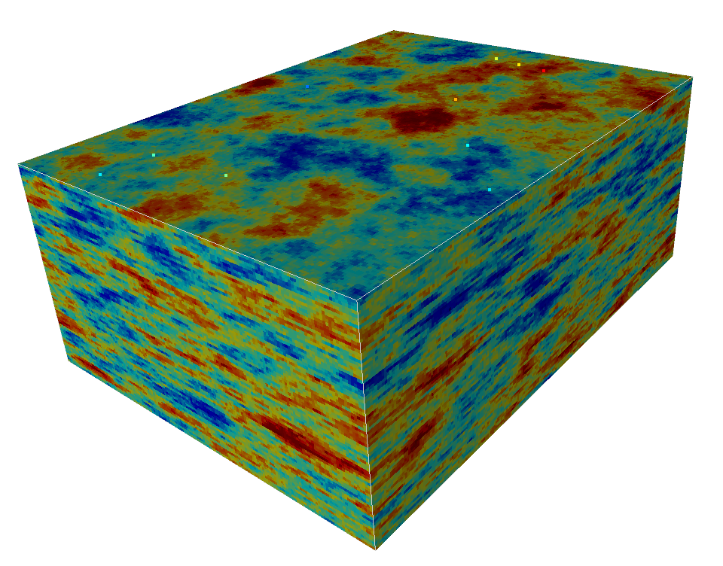
Example spatial stochastic simulation
If I take a fixed input
Range horizontal= 25,
Range vertical = 5
Horizontal Isotropy

Slide 10
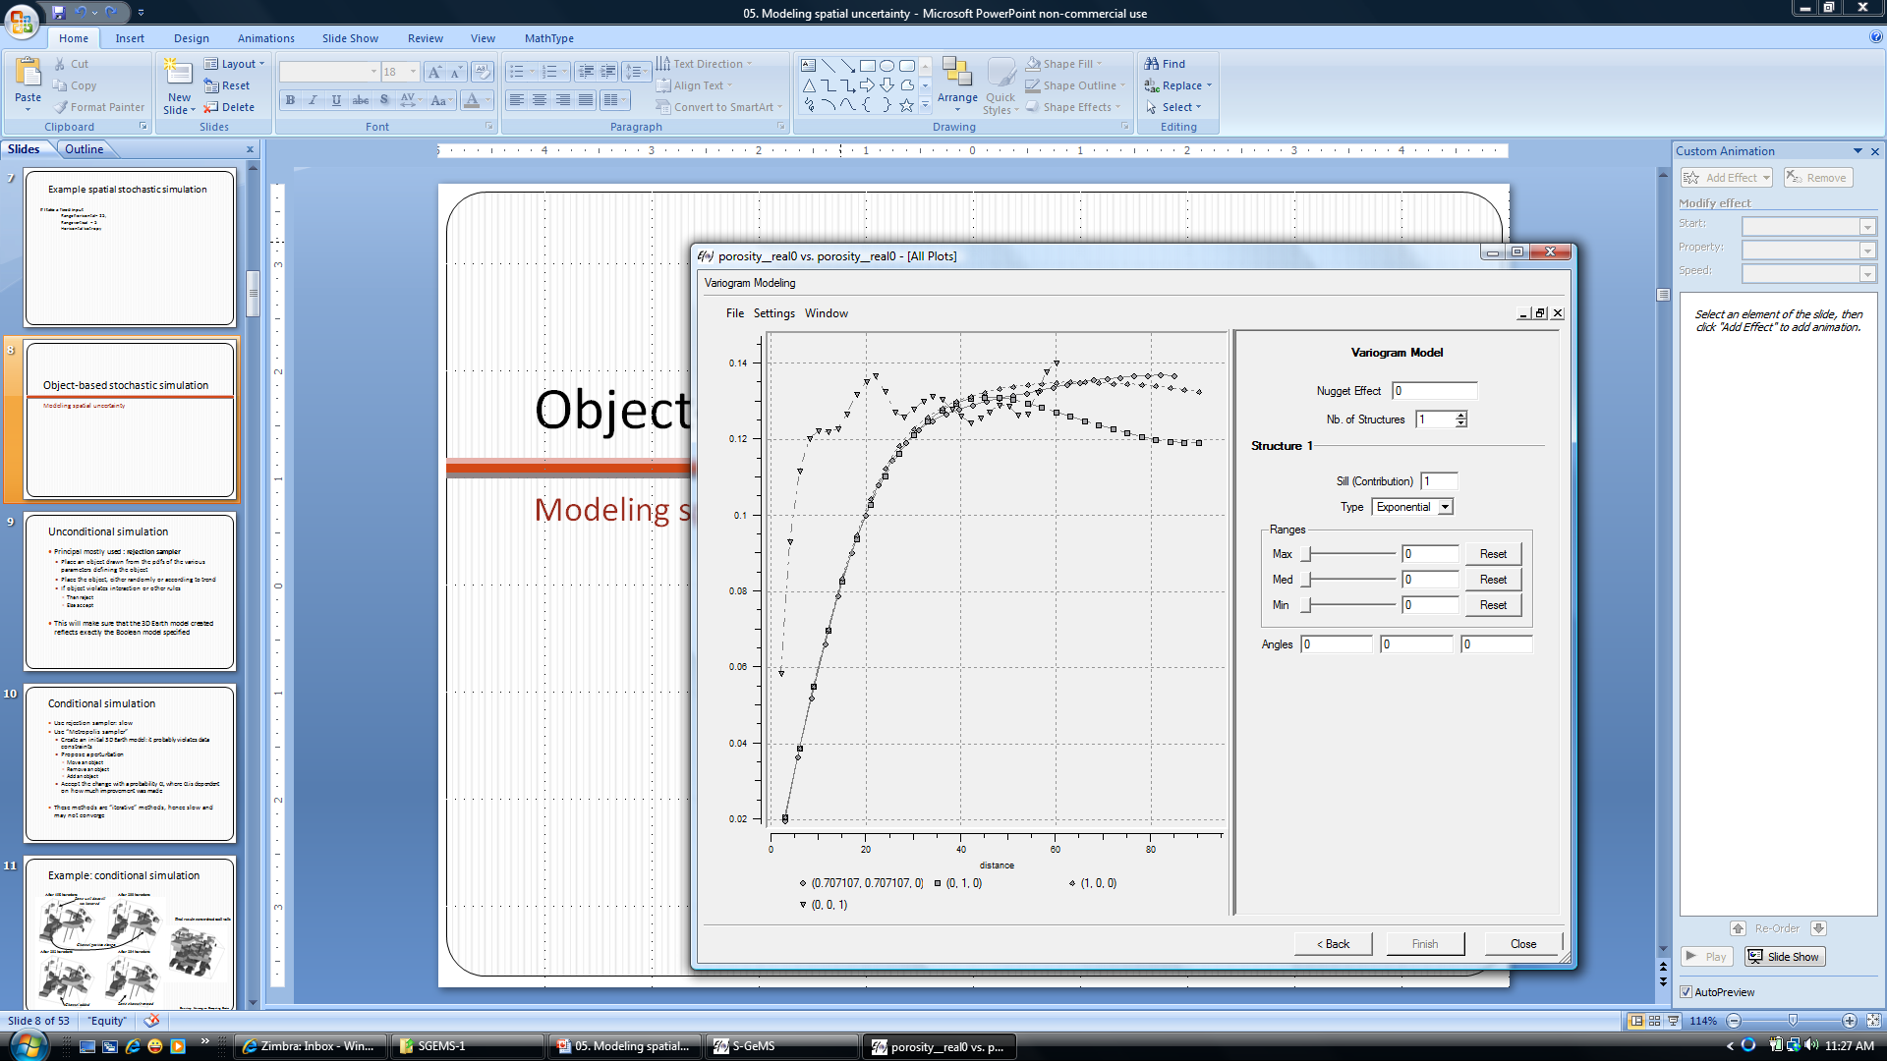
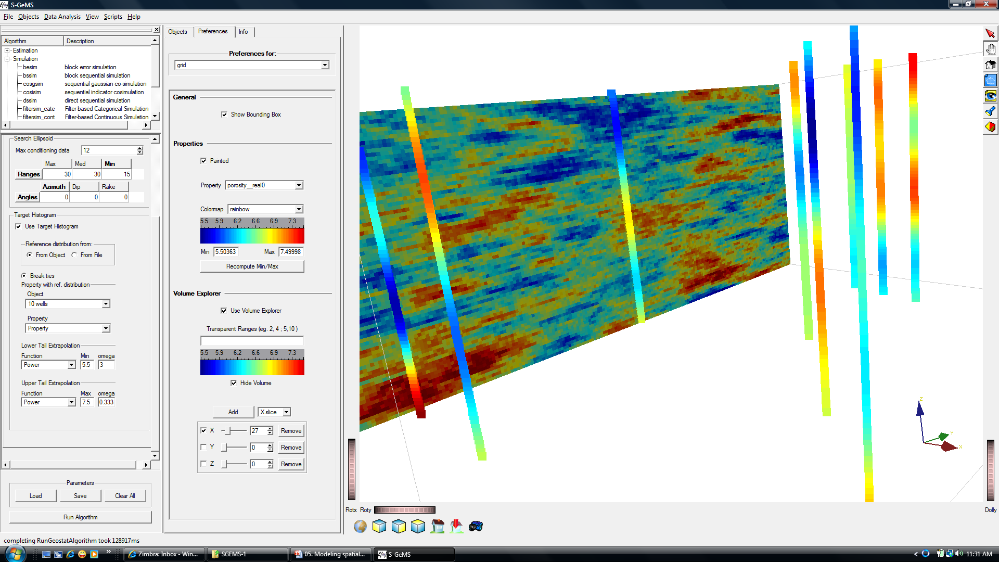
Result
horizontal
vertical
The Earth model reflects our knowledge about
The sampled values at their location
The interpreted spatial continuity model

Slide 11
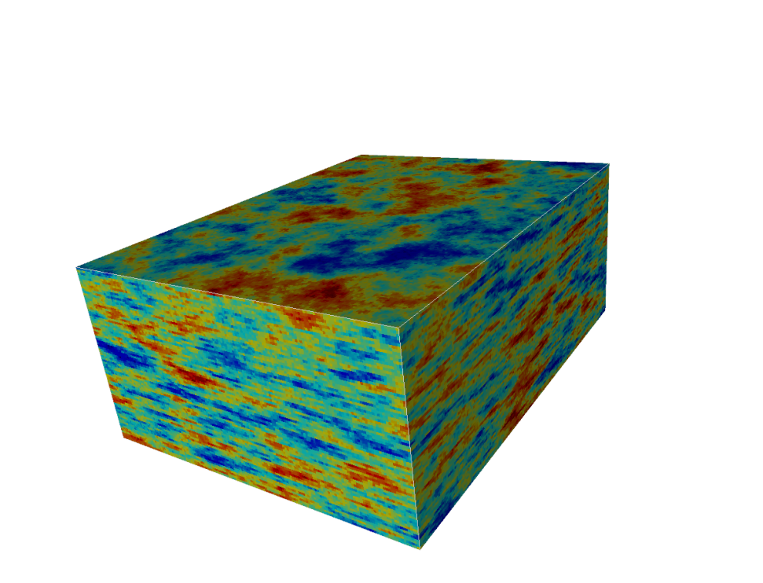
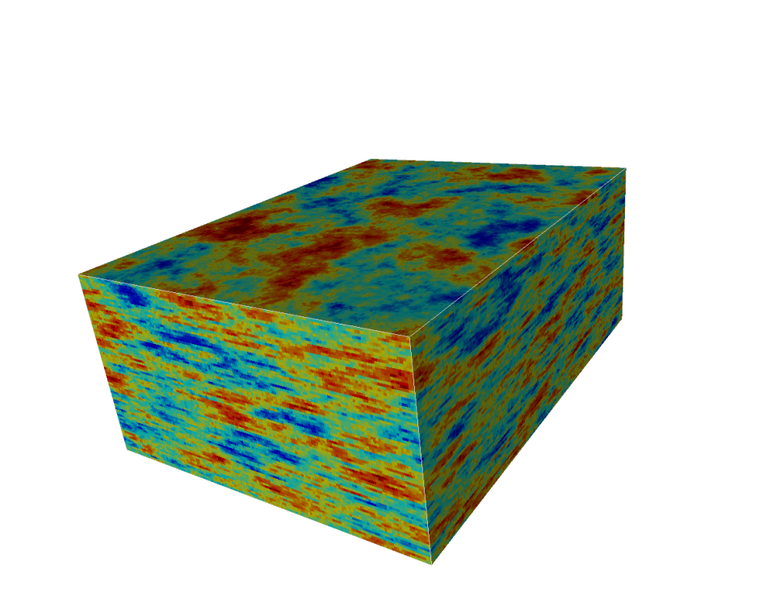
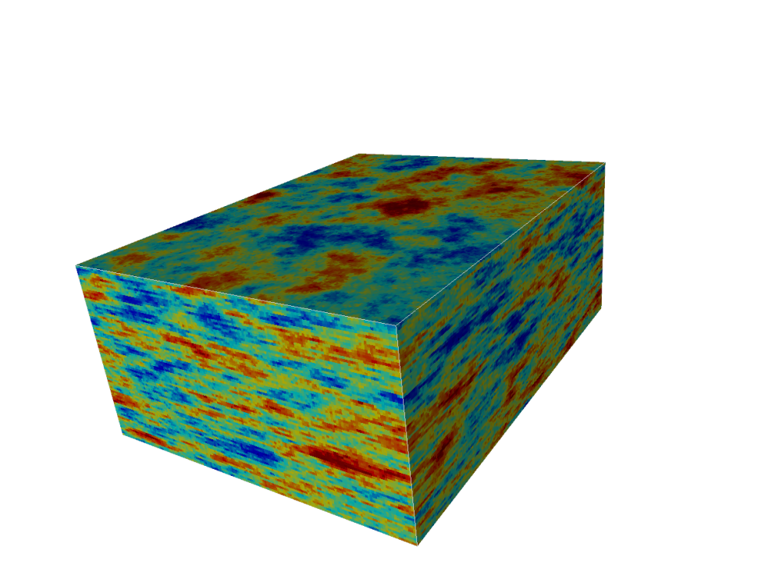
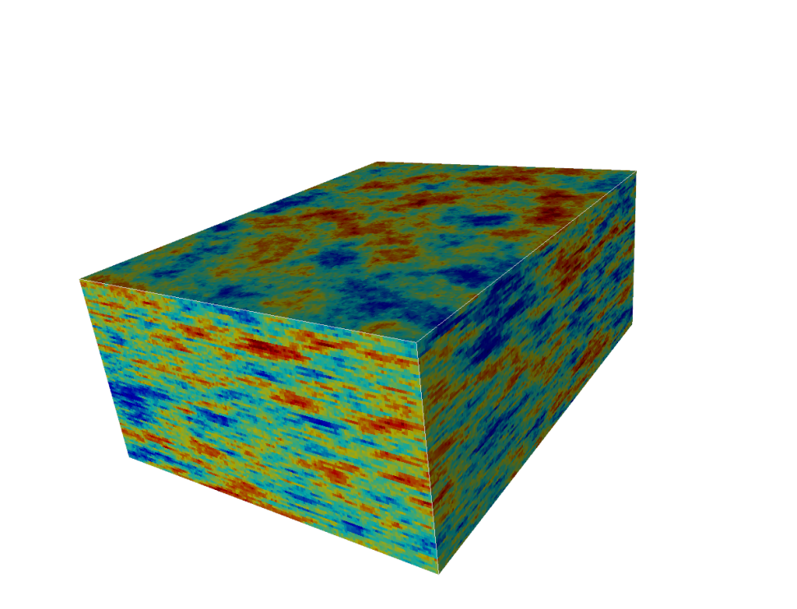
Spatial uncertainty
and infinitely more if you want

Slide 12

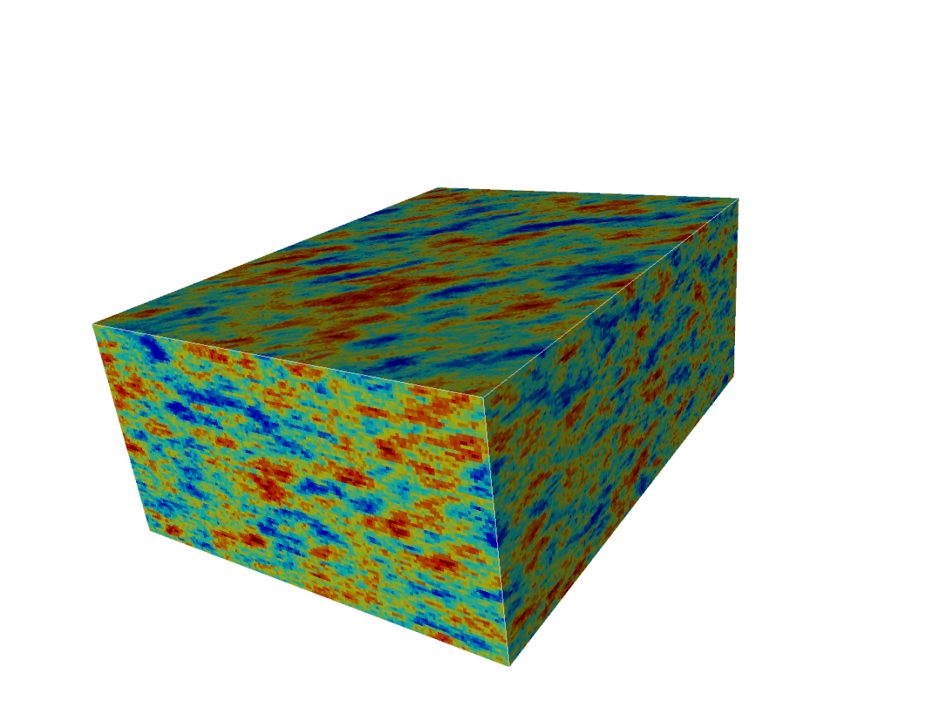

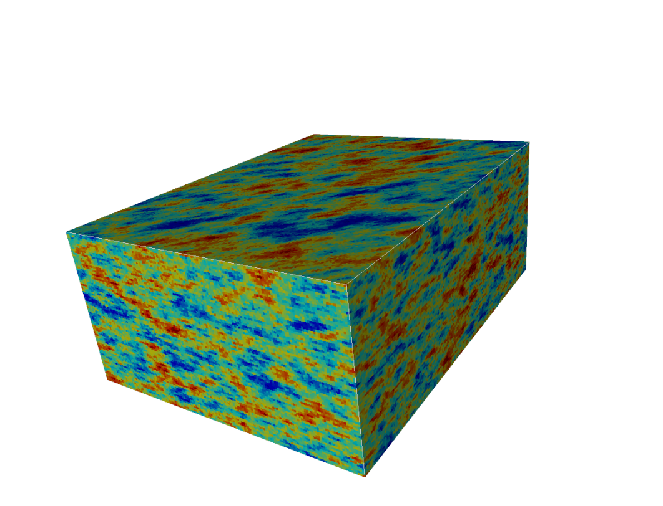
Input and spatial uncertainty
and infinitely more if you want

Slide 13
Object-based stochastic simulation
Modeling spatial uncertainty

Slide 14
Unconditional simulation
Principle mostly used : rejection sampler
Place an object drawn from the pdfs of the various parameters defining the object
Place the object, either randomly or according to trend
If object violates interaction or other rules
Then reject
Else accept
This will make sure that the 3D Earth model created reflects exactly the Boolean model specified

Slide 15
Conditional simulation
Use rejection sampler: slow
Use “Metropolis sampler”
Create an initial 3D Earth model: it probably violates data constraints
Propose a perturbation
Move an object
Remove an object
Add an object
Accept the change with a probability α, where α is dependent on how much improvement was made
These methods are “iterative” methods, hence slow and may not converge

Slide 16
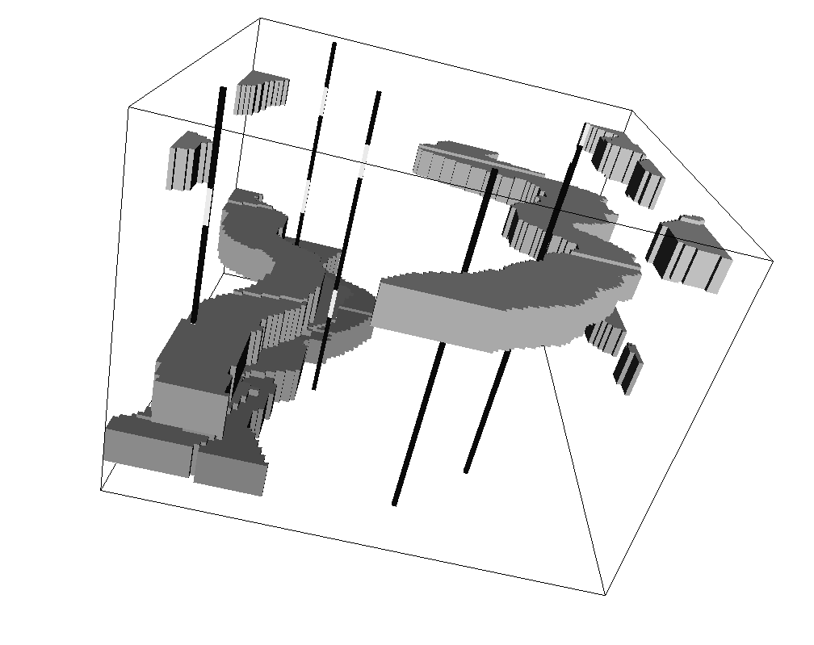
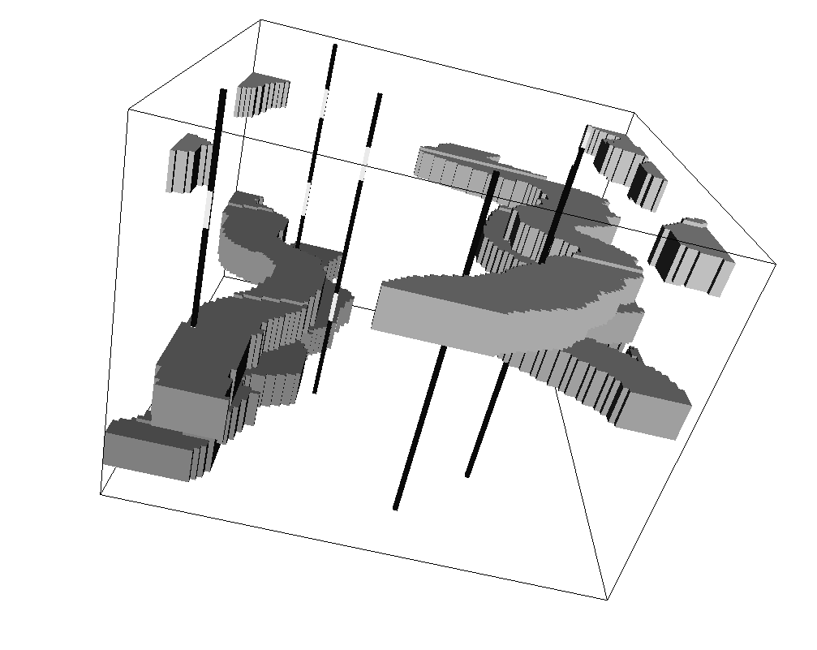
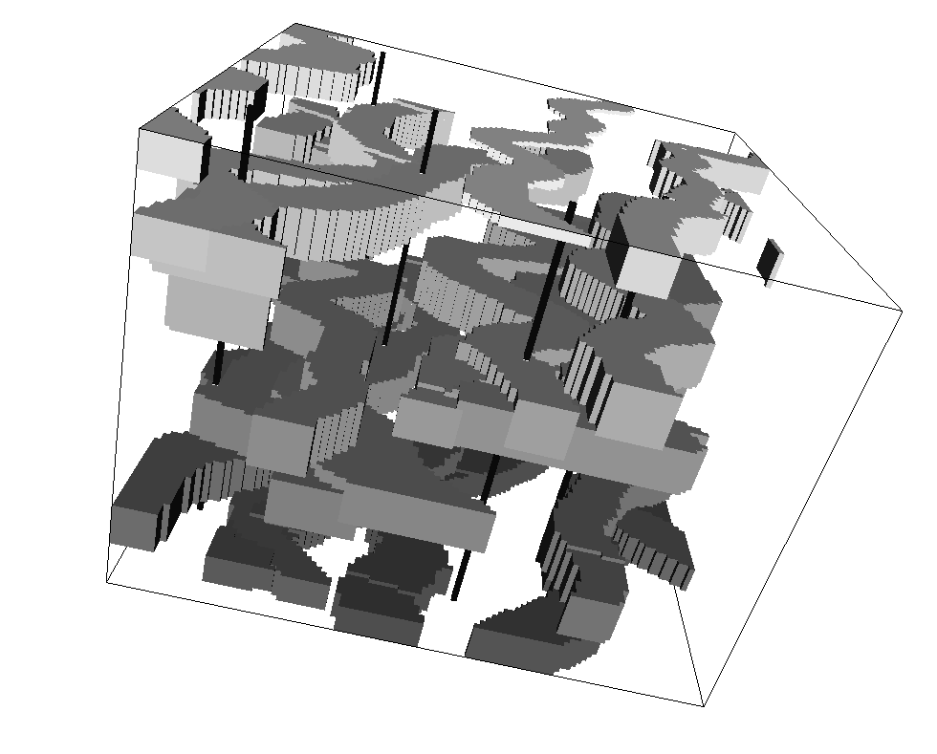
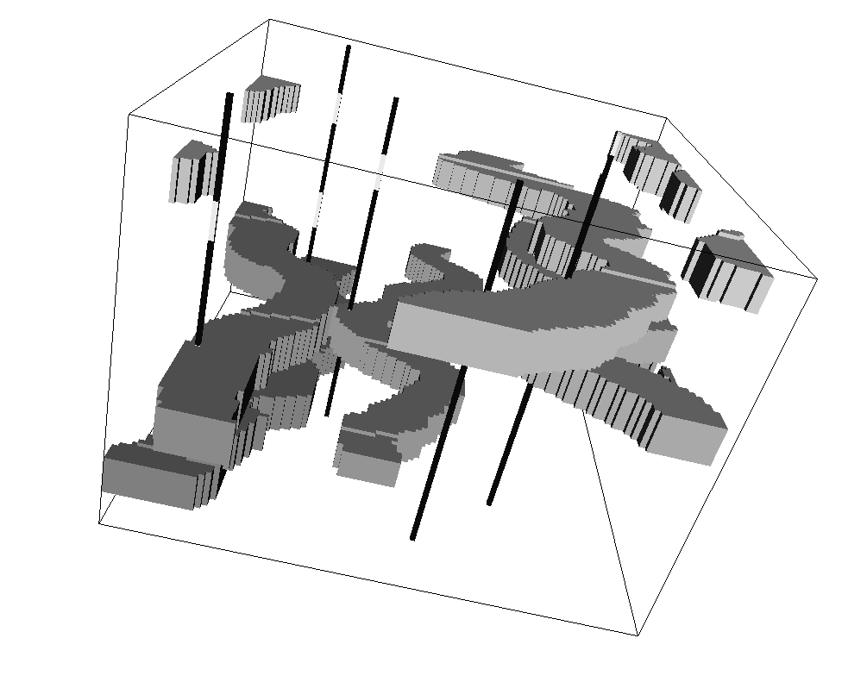
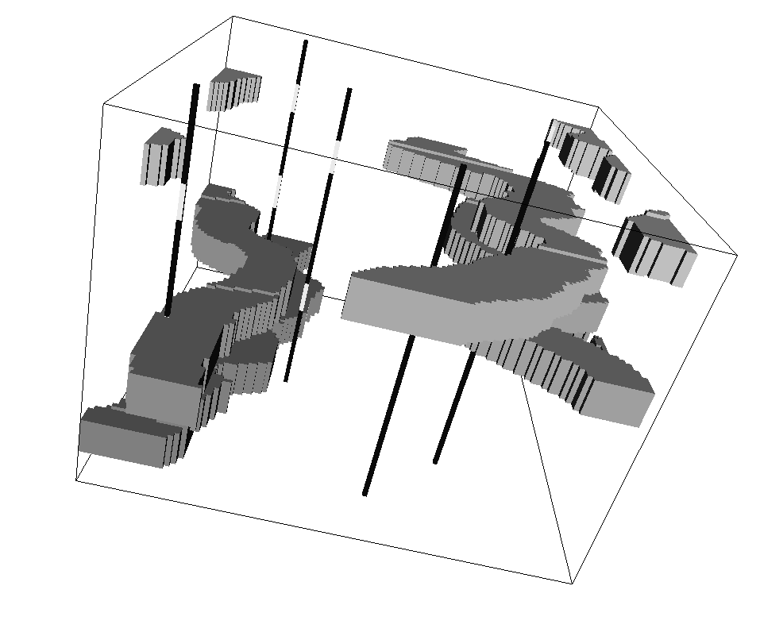
Example: conditional simulation
After 198 iterations
After 200 iterations
Some well data still
not honored
Final result: constrained to all wells
Channel position changes
After 202 iterations
After 204 iterations
Channel added
Same channel removed
Courtesy: Norwegian Computing Center

Slide 17
Conditional Boolean simulation
Too slow for practical Earth modeling involving uncertainty
Any conflict between model and data makes it even slower
Can only be constrained to
Limited amount of well data
Not to geophysical data or more complex data

Slide 18
Training-image-based simulation
Modeling spatial uncertainty

Slide 19
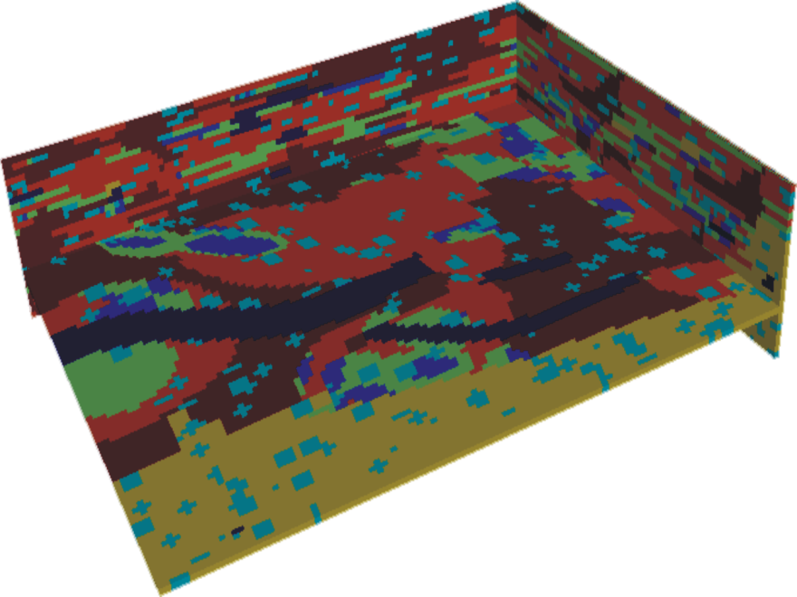
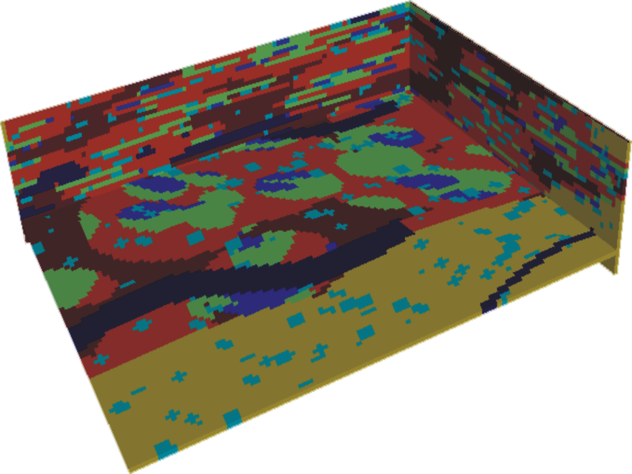
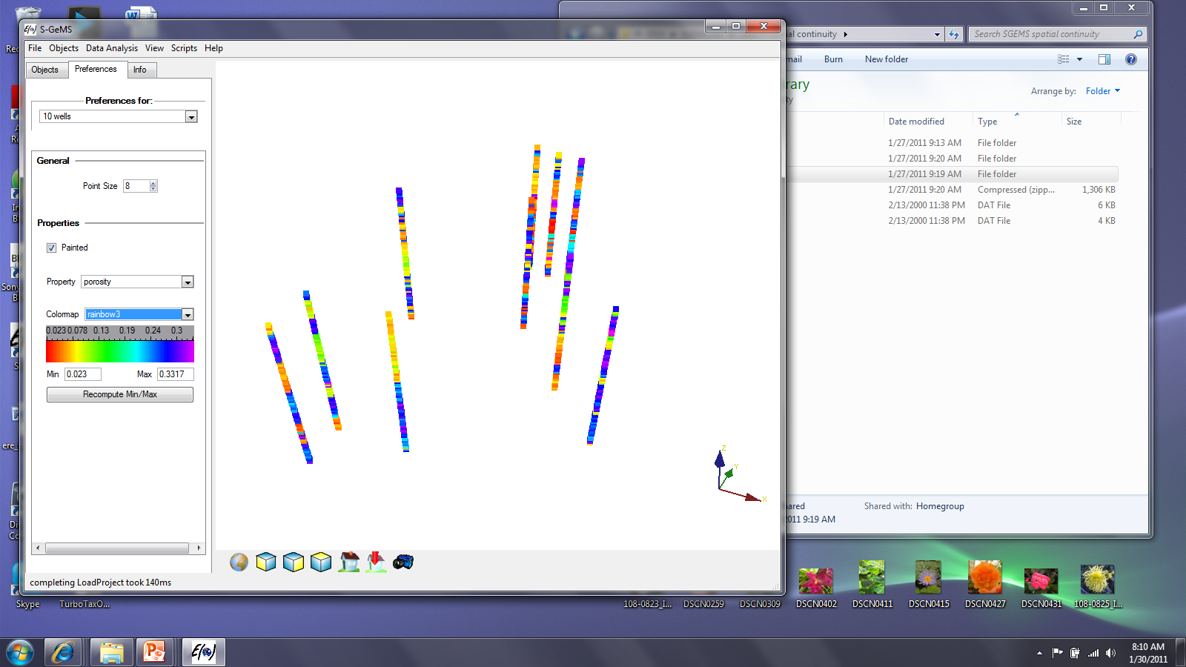
Idea
Conditional Earth model
Generate a single
unconditional Boolean Earth model
Anchor patterns to data
ActualData
Extract 3D Patterns

Slide 20
Principle of sequential simulation

Slide 21
In general
= data
data event
P ( A | B ) ?

Slide 22
Algorithm
Generic sequential simulation algorithm
Assign any hard data to grid cells if required
Define a random path
Loop over all grid cells
Determine P(A|B)
B=any data and previously simulated values
Draw from P(A|B) a value
Add that value to the data set

Slide 23
How to use the training image ?
Simulation grid with some data points

Slide 24
Using a training image
Training image
P ( A | B ) = 1 / 4
A = blue

Slide 25
Scanning is CPU-demanding
Simulation grid with some data points
u₂
u?
u₃
u₄
u₁
Template

Slide 26
Create a data-base
Training image
Search tree
Construction requires scanning
training image one single time
Minimizes memory demand
Allows retrieving all training
probabilities for the template
adopted

Slide 27
Spatial continuity at large scale
Freeze coarse grid nodes and use them as conditioning data to simulate finer grid nodes
Training image
Finer simulation grid
Coarse simulation
grid
fine
template
Coarse
template

Slide 28
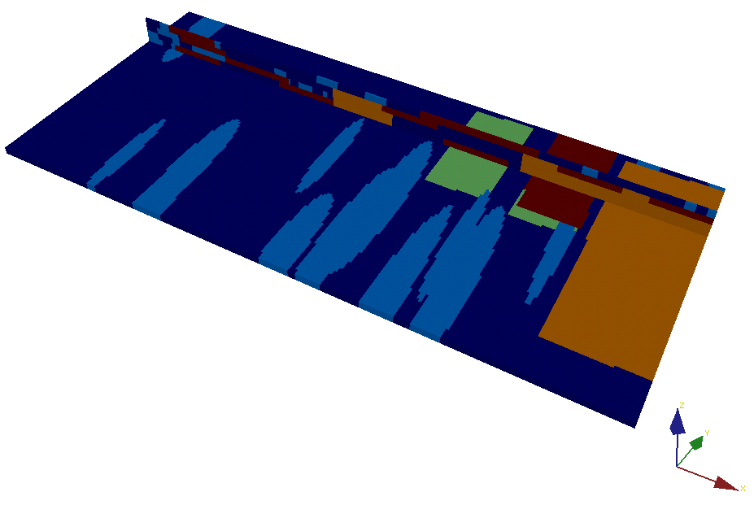
Example
Training image
Background
shales
Tidal sand
flats
Transgressive
lags
Tidal bars
Estuarine
sands

Slide 29
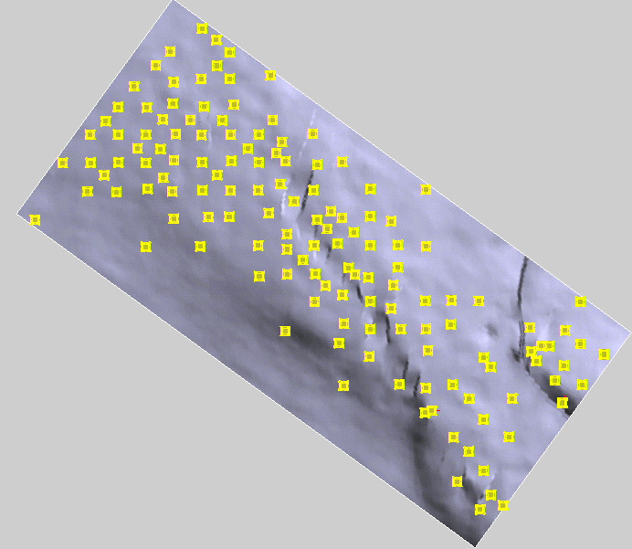
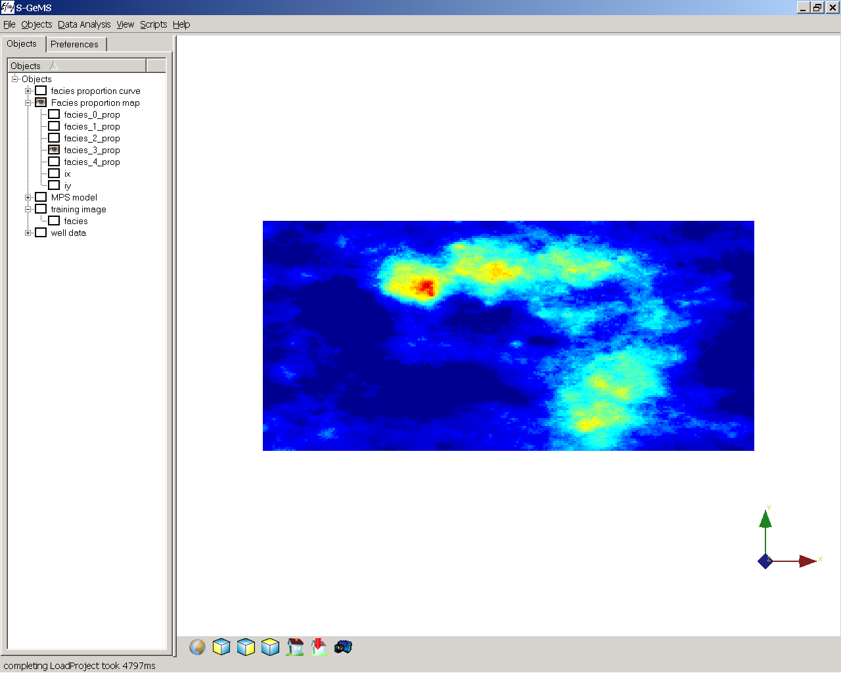
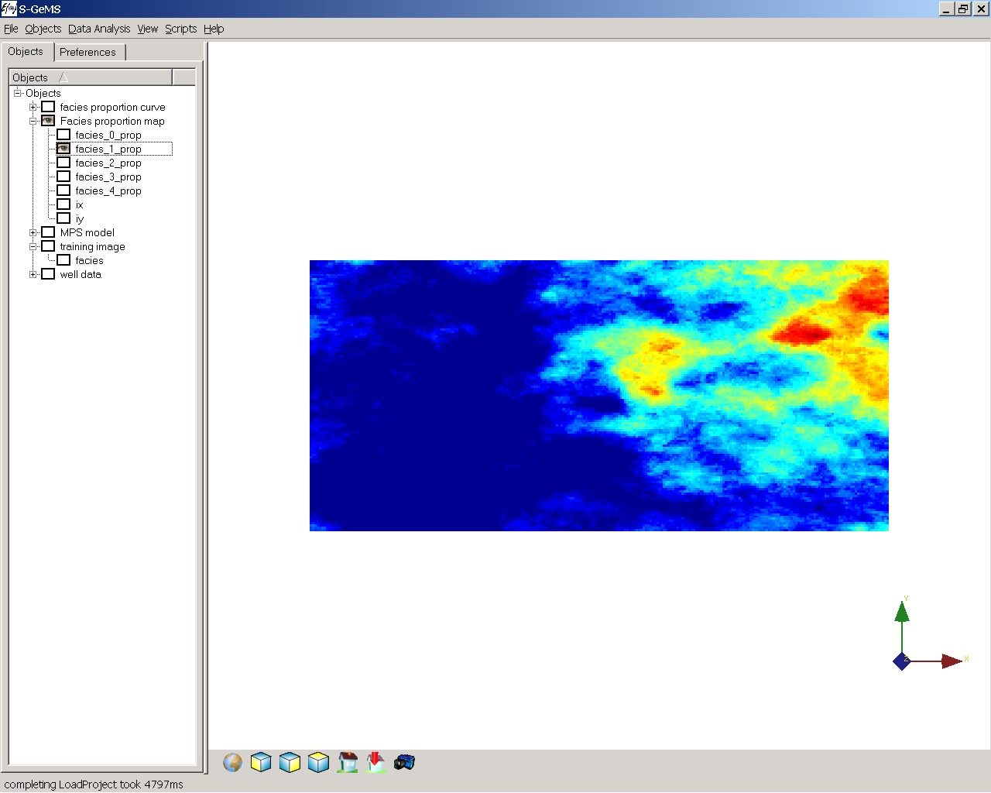
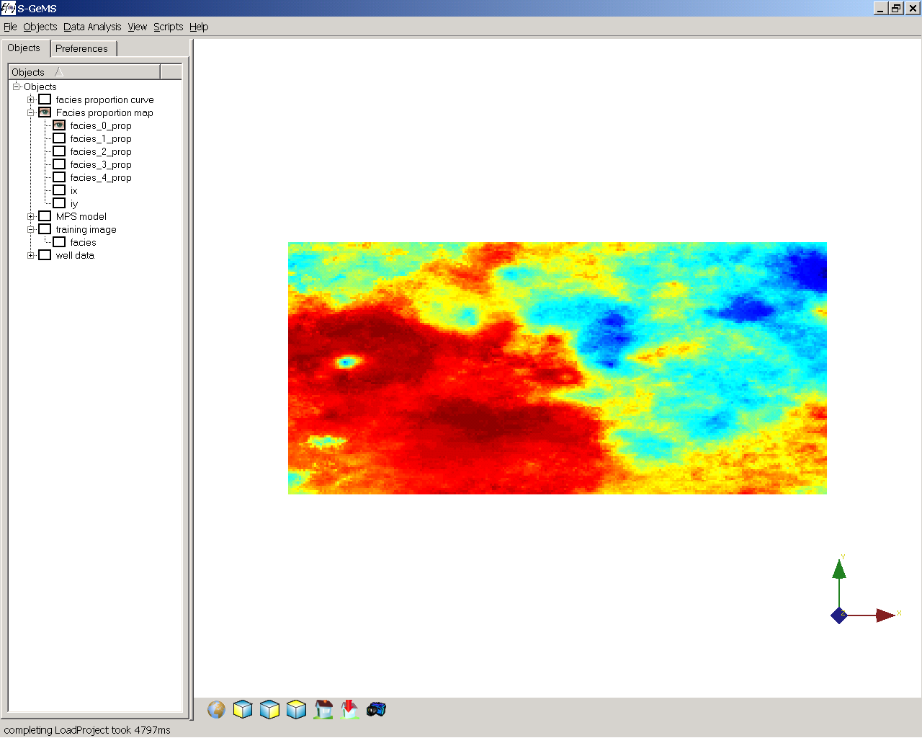
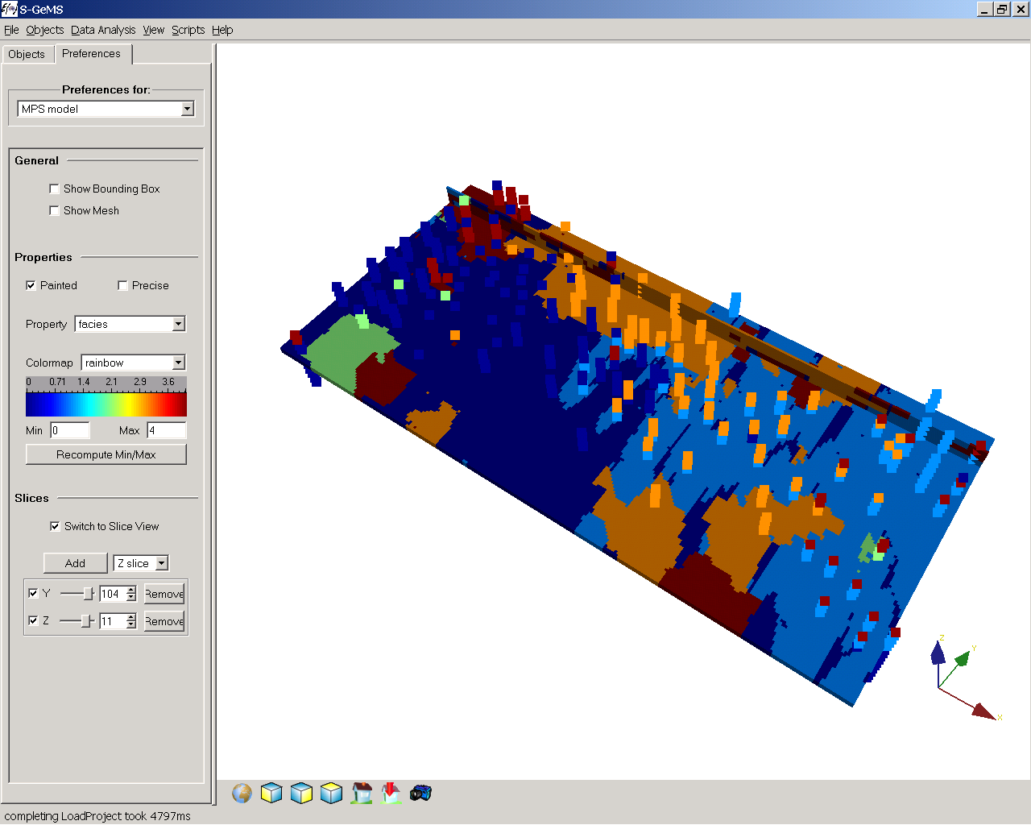
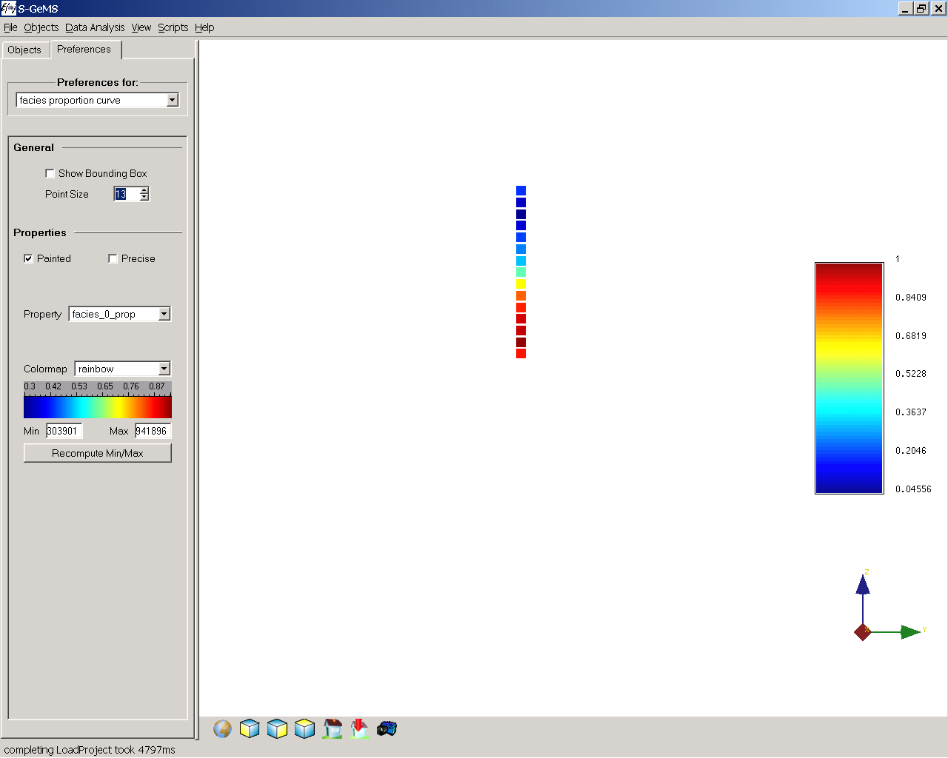
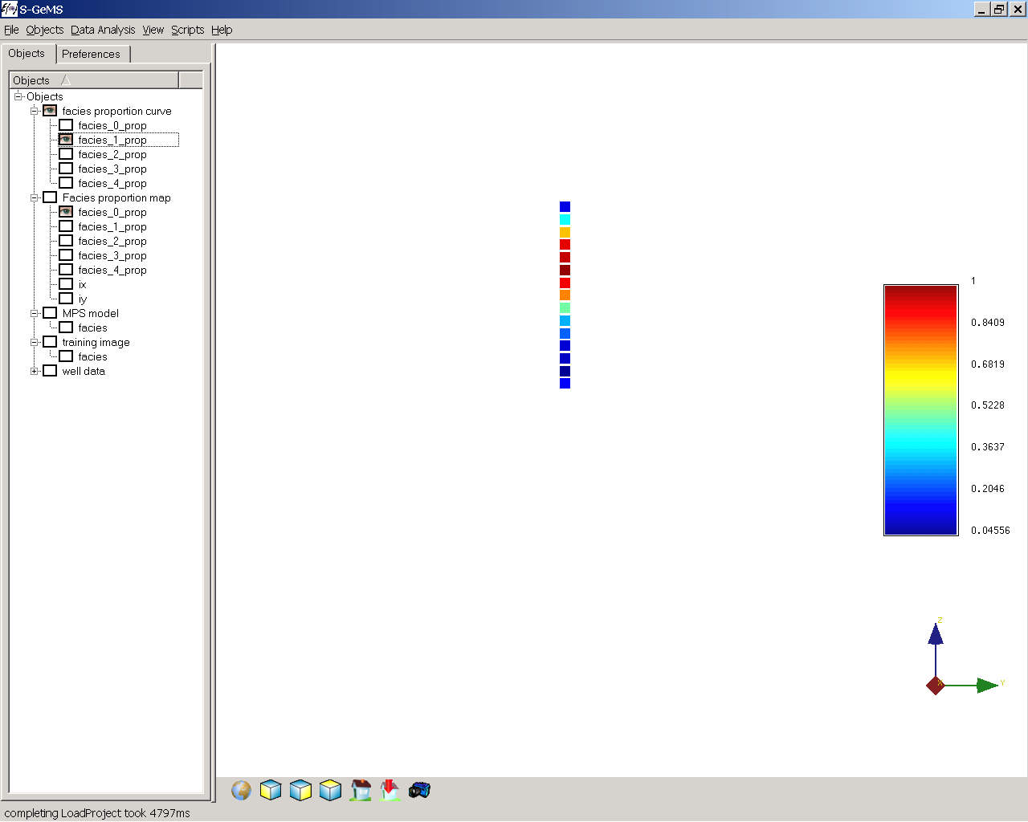
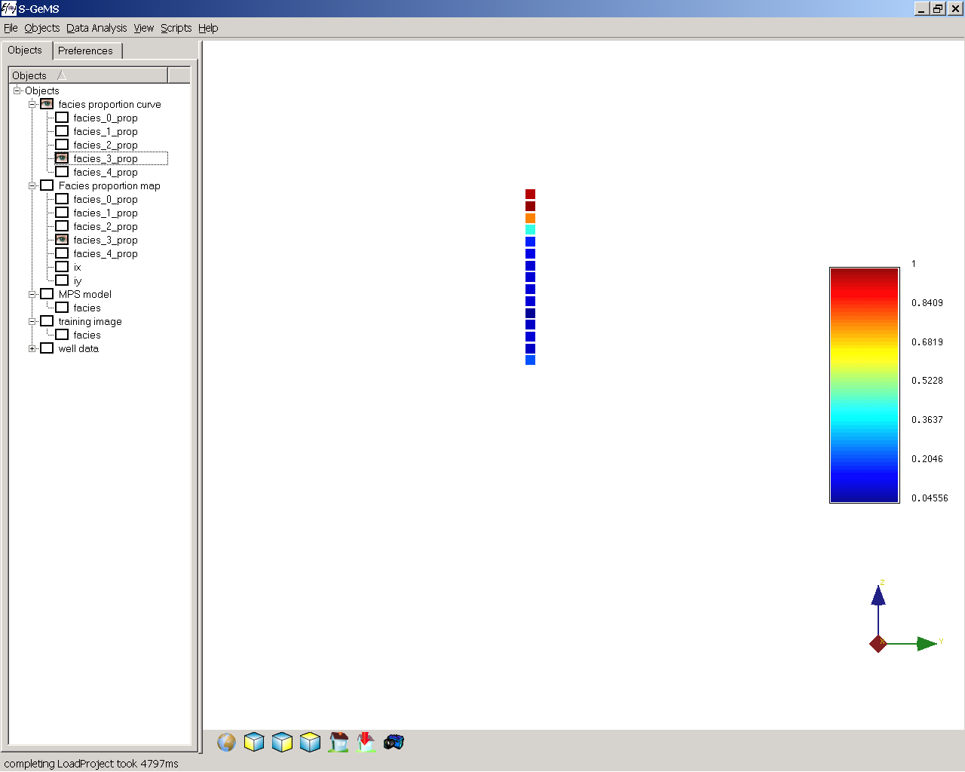
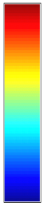
Example
N
Plan view of stratigraphic
grid with location of
the 140 wells
Aerial proportion maps
Estuarine sands
Sand bars
Background shale
Vertical proportion
curves
1
N
Background shale
Estuarine sands
Sand bars
0
Facies model
N

Slide 30
Variogram-based simulation
Modeling spatial uncertainty

Slide 31
Introduction to spatial estimation
Data point
?
Spatial estimation = What is the best guess for
the value at the location where no data was taken ?
There is only one single guess that is the best
Depends on what you determine as “best”

Slide 32
What is best?
Best = as close as possible to the unknown truth
Consider a situation where you want to estimate the total amount of pollution of Pb at a specific location. You have two methodologies do so. Consider that you apply these methodologies to 10 sites

Slide 33
Estimation: principles

Slide 34
Estimation: principles
Unbiased: the average error is zero (it is a property measured over many “trials”
Best ?
Average square error is zero ?
Absolute value of error is zero ?
loss
-error
+error

Slide 35
Introduction to Kriging
What is kriging ?
Is an estimation method
Finds the “best” (Least Square) linear estimate of the unknown
Accounts for the variogram
* Spatial correlation between unknown and data
* Redundancy between data
But is mostly used in sequential simulation

Slide 36
Linear estimation
Problem
Inverse distance solution

Slide 37
Inverse distance mapping
1
1
2
2
3
3
Situation 1
Situation 2
λ₂=1/3
λ₂=1/4
λ₁=1/3
λ₁=1/4
λ₃=1/3
λ₃=1/2
Inverse distance
kriging

Slide 38
Linear estimation
To be estimated
Data
?
Direction of major continuity
Principle 1: a datum close in “geological distance” to
the unknown should get a large weight
Principle 2: Data close together are redundant and
should “share” their weight

Slide 39
How does kriging do it?
z(u₁)=0.5
h₁₂
z(u₂)=0.9
h₁₃
h₂₃
z(u₃)=1.5
Record all the distance between
Data locations
Data location vs location of unknown
Calculate the covariance function for those distances

Slide 40
How does kriging do it?
Solve this linear system of equations
Note: mean = assumed zero

Slide 41
What is the average error we make?
Solve this linear system of equations
Note: mean = assumed zero

Slide 42
Example
d
?
d
ε
Note: mean = assumed zero

Slide 43
Various “flavors” of kriging
Simple kriging
You assume there is no trend
You assume you know the mean of the variable over the domain
Ordinary kriging
You don’t want to assume anything explicitly
Kriging with locally varying mean
You assume there is a trend and you know that trend exactly
Kriging with trend
You assume there is trend but you only know the type of trend (don’t know it exactly its magnitude)

Slide 44
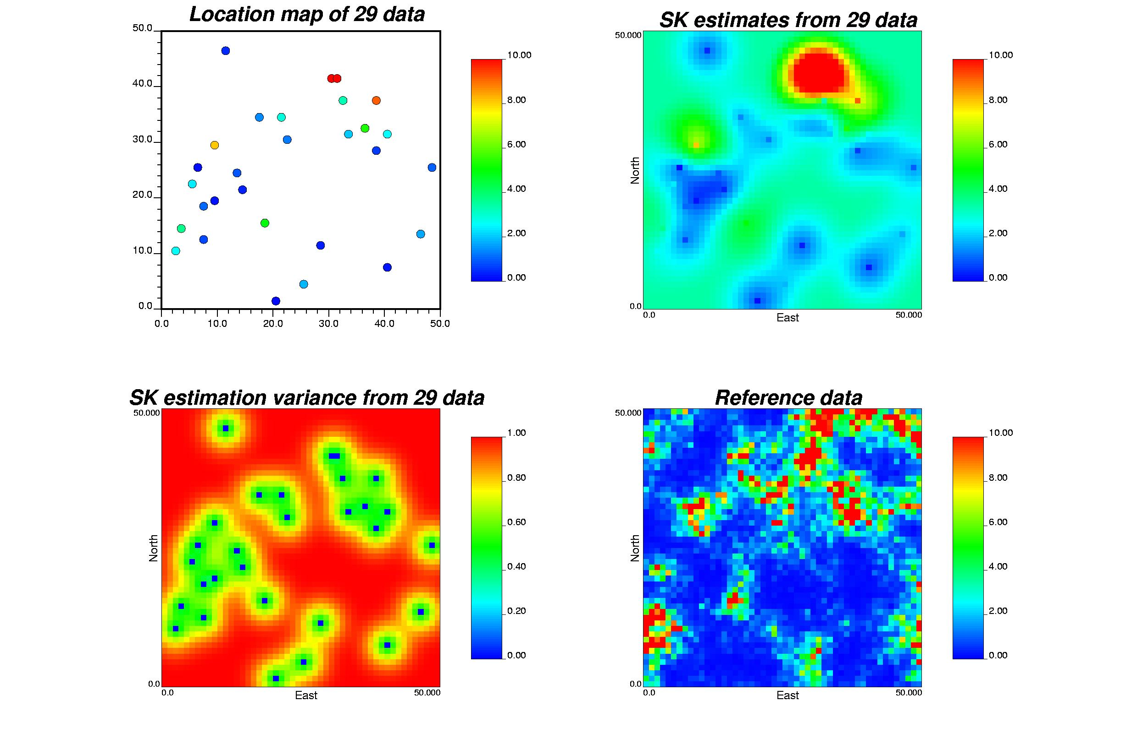
Example

Slide 45
Back to sequential simulation
Assign any hard data to grid cells if required
Define a random path
Loop over all grid cells
Determine P(A|B)
B=any data and previously simulated values
Draw from P(A|B) a value
Add that value to the data set

Slide 46
Kriging is not simulation !
Kriging: what is the best guess?
?
?
Simulation: what is the uncertainty as
expressed through a probability
or probability distribution or a set of
Possible outcomes

Slide 47
Gaussian simulation
Variance: σ²
?
Mean: μ

Slide 48
Transformation of the data
Gaussian simulation assumes the data is Gaussian
Problem ?
Prior to simulation,
perform a normal score transform of the hard data
After sequential visit of all cells, perform a back-transform
which is the exact reverse of the normal score transform

Slide 49
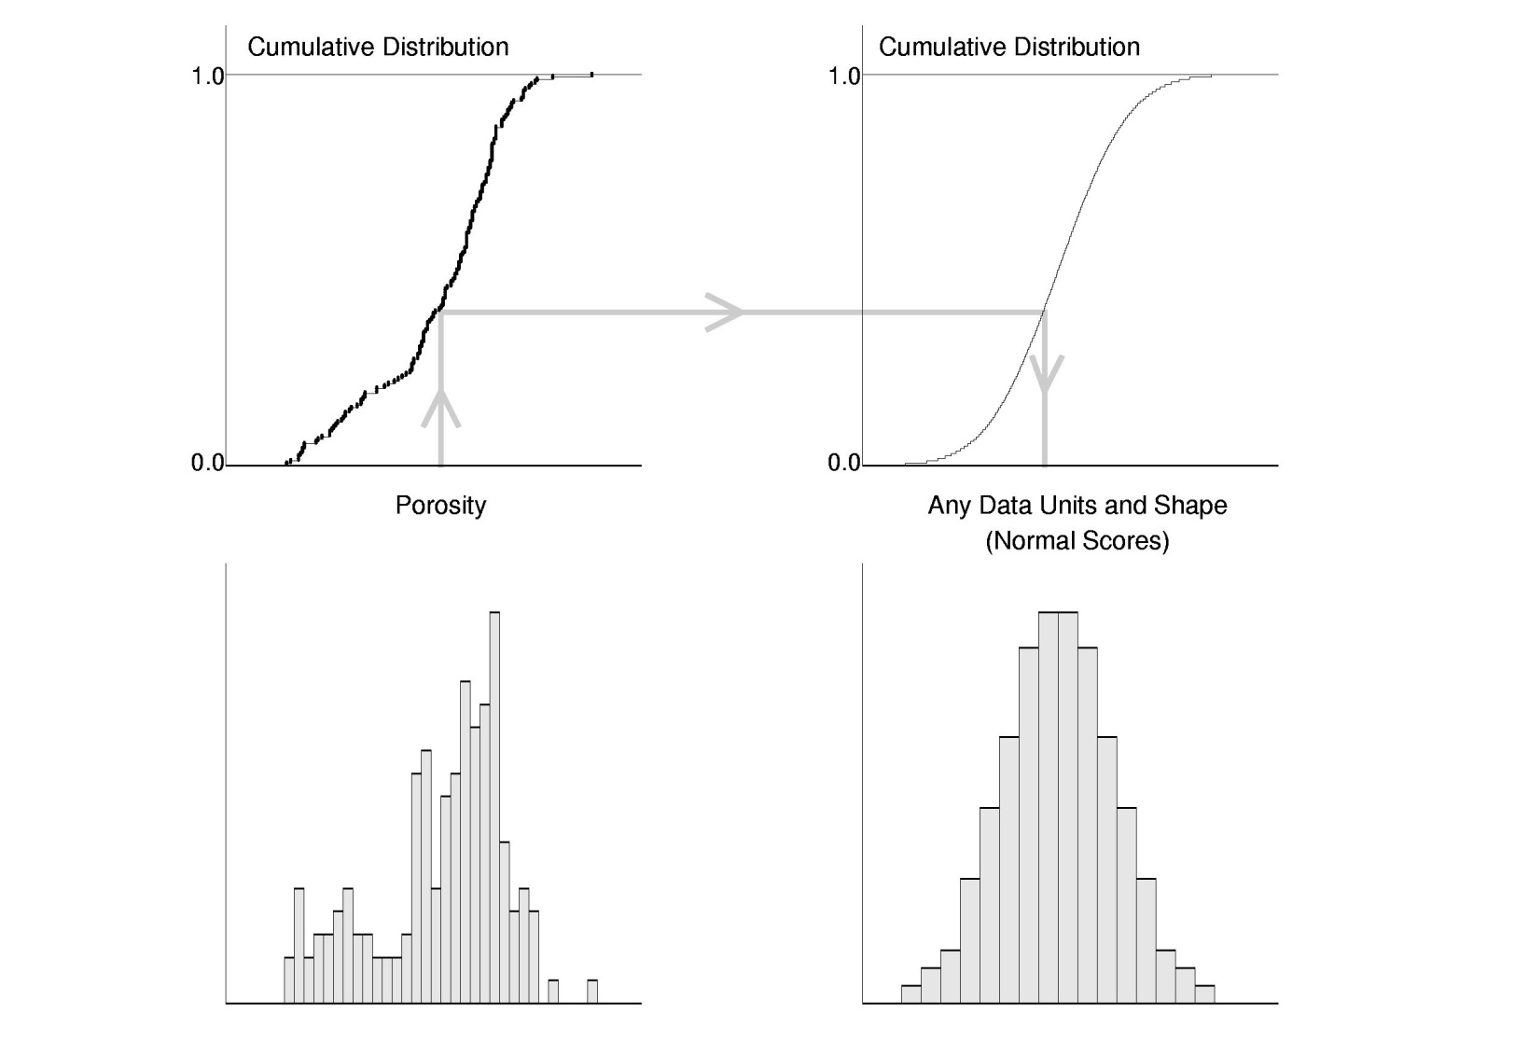
Normal score transform
Unit free

Slide 50
Complete SGS algorithm
Transform the data into normal score domain
Assign any hard data to grid cells if required
Define a random path
Loop over all grid cells
Determine, using kriging, the distribution P(A|B)
B=any data and previously simulated values
Draw from P(A|B) a value
Add that value to the data set
Back-transform all simulated values (requires extra/interpolation)

Slide 51
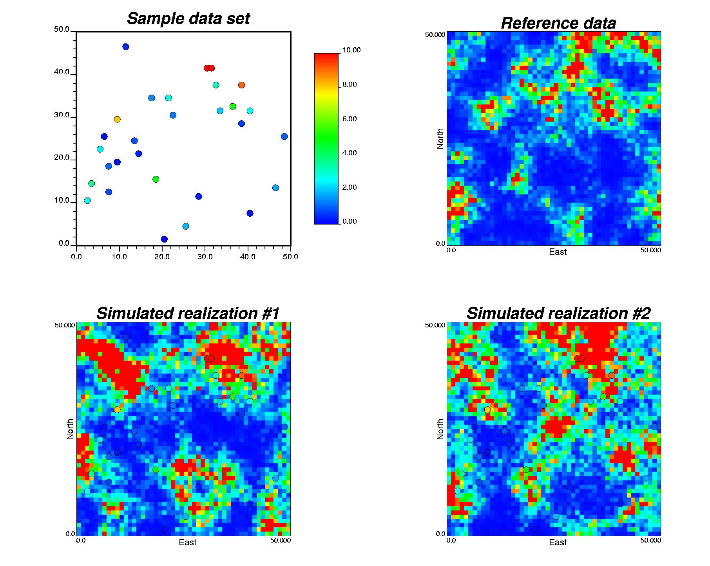
Example

